Slide 1
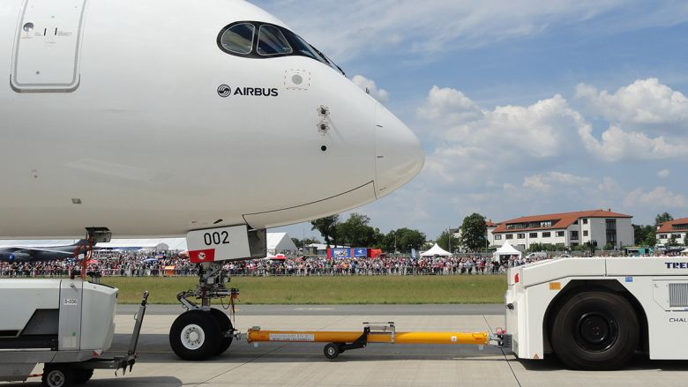

Material Selection Process for Tow-Bar System
SEMESTER PROJECT PRESENTATION
The Explorers
Deepak Gidhwani
Ishan Sharma
Notes:
Good Morning Everyone!
We hope you all are doing well.
So Here we are – Team Explorers!
We’ll be presenting the Material Selection process for Towbar System
By the Glimpse of picture itself, it explicitly clearly the towbar system design will be made specifically for Aviation Ground Operations like – Pushback
So, Without Wasting any more time, Lets explore the process!

Slide 2
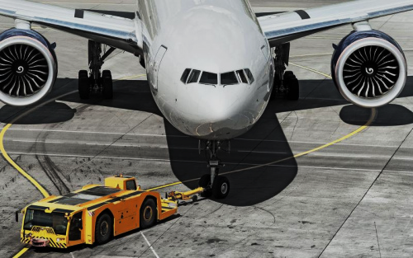
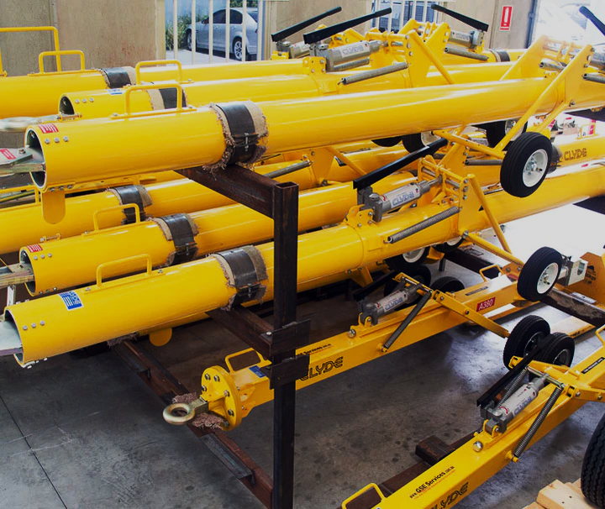
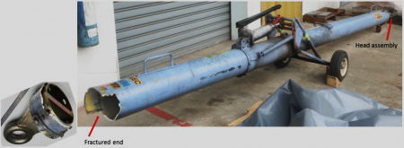

Introduction & Motivation
SEMESTER PROJECT PRESENTATION
2
Notes:
Introduction –
Why Towbar ? As to what’s the driving force or the motivation behind selecting towbar as a topic for our study
As we know, With Aircraft’s devoid of Reverse mechanism, that’s the reason they need a vehicle to push them back on the runway
Towbar serves the function.
Towbar is very integral part of very important part of the ground operations, used as mechanical linkage in between the NLG i.e., Nose Landing Gear and the pushback truck. It’s used for Pushback and Pull-up operations for wide range of Aircraft somehow significant dynamics are involved in its design. It holds for roughly 0.36% of the operational costs of the Aviation Industry

Slide 3
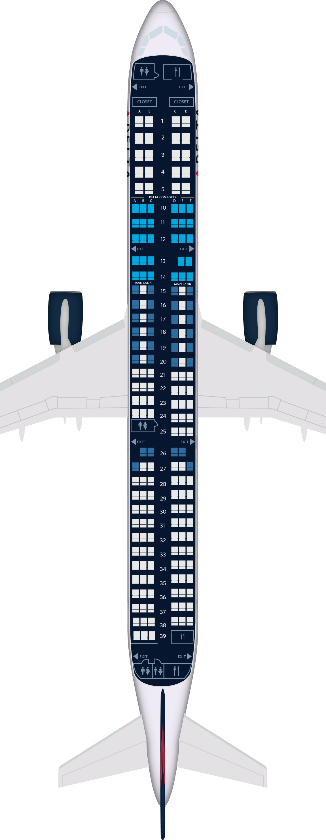
Design Baselines
Base Material: Steel (AISI 4130)
Product Application (in reference) : Commercial Passenger Aircraft towing operations
Product Design Baselines: Towbar for A321 (Narrow Body Aircraft)
Maximum Take-Off Weight: 103 Tons/93500 kg (Approximately)
SEMESTER PROJECT PRESENTATION
3
Notes:
In this slide, We’ll talk through the design baselines involved in the given process
The base material utilized extensively is – AISI 4130 referred from different A3 OEM manuals, Product Application for the given project is limited to Commercial Passenger Aircraft Towing Operations
Design Baselines in this case has been taken as the Narrow Body Airbus A321 Aircraft, Maximum Take-Off Weight would be one of the design load constraints to lead the analysis further

Slide 4


Design Regulations & Compliance
Permissible Design limits of Towbar have been set by FAA under FAR.
Design of Towbar is constrained with minimum and maximum lengths for safe-limits for pushback and pull-across operations and compliance with the same is mandatory.
(Advisory – AC 00-65 & Title 14)
FOS (Factor of Safety) (Towbar Operations): 1.5 – 1.95
SEMESTER PROJECT PRESENTATION
4
Notes:
This slide talks about the Design Regulations & Constraints which come over due to Federal Aviation Regulations set up by Federal Aviation Administration
Length of Towbar is constrained under by Upper Bounds and Lower Bounds for Safe Operations by FAA under Title 14 and advisory AC 00-65
Even the Factory of Safety for towing operations have been specified, it ranges from 1.5 – 1.95, for our analysis we’ll be hitting the right-extreme i.e 1.95

Slide 5
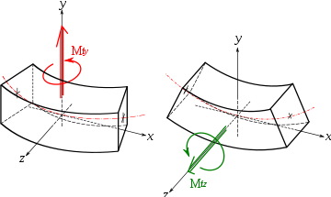
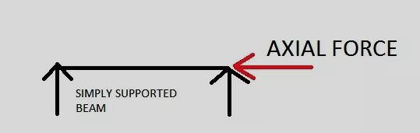
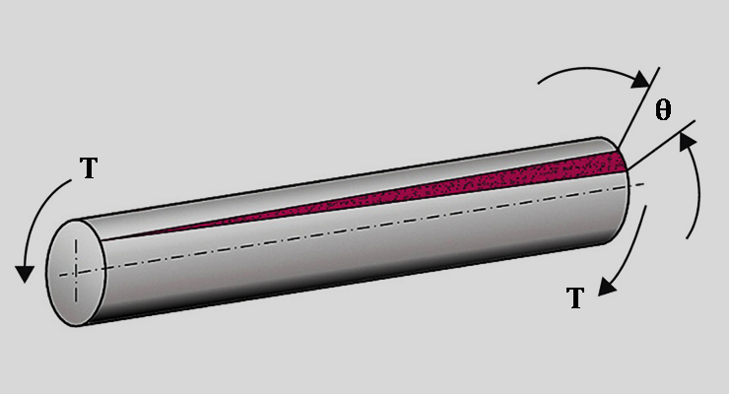

Factors Involved: Load Profile
Reference: A³ , US Army Material Technology Laboratory
Majority Forces Applied (Experimental Results of Physical Testing):
Axial Loads (Majorly)
Bending Load (Friction between Lunette and pintle)
- Torsional Load (Zero to Minimalistic)
SEMESTER PROJECT PRESENTATION
5
Notes:
In this section, we’ll start to glance through the factors involved in the given design, starting with load profile, as to what all loads the tow bar is subjected to.
The load profile reference has been taken from Experimental tests conducted by A3 and US Army Material Technology Laboratory
Majority of the Load is Axial Load, due to axis-symmetric pushback operations, Followed by significant amount of Bending Load which is due to the friction between Lunette and Pintle
Torsional load is zero to very minimalistic
(Due to Universal Joint Connections at ends)
(To allow adequate degree of freedom about rotation)
Swaying forces i.e along lateral movements have been neglected due to low-speed operations

Slide 6

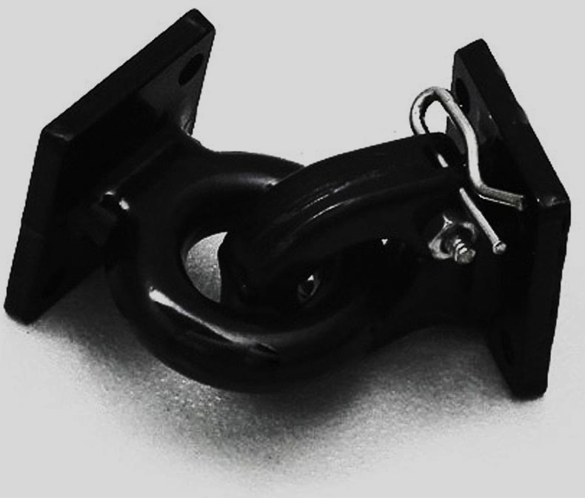
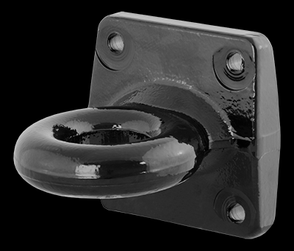
Problem Formulation
FUNCTION:
Tow-Bar System (for Aviation Ground Operations)
CONSTRAINTS:
Geometric Criteria:
Minimum Length and Maximum Length Specified as per FAR
Lunette and Pintle Dimensions are fixed
Strength Criterion: It must possess adequate strength to function under compressive load environment and withstand critical buckling load
SEMESTER PROJECT PRESENTATION
6
Notes:
Further, after observing through the load profile, We’ll further formulate our problem.
Starting with Function, Function: A Tow Bar System for Aviation Ground Operation
Then, further diving into the constraints, lets begin with geometric constraints, wherein the minimum length and maximum length is specified as per Federal Aviation Regulation
Lunette and Pintle Dimensions are Fixed

Slide 7
Problem Formulation
CONSTRAINTS
Stiffness Criterion: Must have adequate stiffness to withstand any deformation during the transportation
NVH Criterion: Ability to Damp axis-symmetric excitations/longitudinal excitations in the line of pushback operations
Fracture Toughness Criterion: It must possess adequate Fracture Toughness to resist flaw-propagation in the operational environment
Corrosion Resistance
SEMESTER PROJECT PRESENTATION
7
Notes:
Continuing with the constraints in the next slide
Stiffness Criterion: to adequately withstand deformations across the given structure of towbar
Further, talking about the NVH Criterion, The ability to damp axis-symmetric excitations
The towbar should posses adequate fracture toughness to resist crack propagations during its operational hour.
Lastly, It should posses Corrosion Resistance.

Slide 8
Problem Formulation
CONSTRAINTS
It should have an ability to withstand Buckling
OBJECTIVE:
Minimize Mass
Minimize Cost
FREE VARIABLES:
Section Area
Choice of Material
SEMESTER PROJECT PRESENTATION
8
Notes:
Furthermore, Ability to withstand Column Buckling and Shell buckling The area should be distributed in such a way that the design could prevent buckling
Now coming to the objective of the problem is to minimize mass and minimize cost,
(Minimizing Mass would empower the design on the lines of ‘Ease of Operation’ by Ground Staff and Minimize Cost would certainly reduce the operating cost, as it accounts for roughly 0.36% of the operational cost component of the aviation operations.

Slide 9
Selection Process – Bounding Box Calculations
Design Load Profile : 200 Tons (FOS: 1.95)
Tube Specimen | Area of Cross-Section (m²) | Yield Strength (MPa)
T1 | 0.00190 m² | 940 MPa
T2 | 0.00280 m² | 636 MPa
T3 | 0.00320 m² | 556 MPa
T4 | 0.00429 m² | 414 MPa
SEMESTER PROJECT PRESENTATION
Yield Strength Range:
410 MPa – 940MPa
9
Notes:
The bounding boxes in the selection procedure, have been based on the Strength Criterion i.e., Yield Strength
In the calculations, Maximum Cross-Sectional Area and Minimum Cross-Sectional Area which is coherent with lunette and pintle design for the Aircraft have taken the basis for the bounding boxes for the selection process
Four Possible Tube Cross Sectional Area’s define the Maximum and Minimum Yield Strength for the Given application.
Yield Strength Range after calculations lies between 410 MPa and 940 MPa respectively.

Slide 10
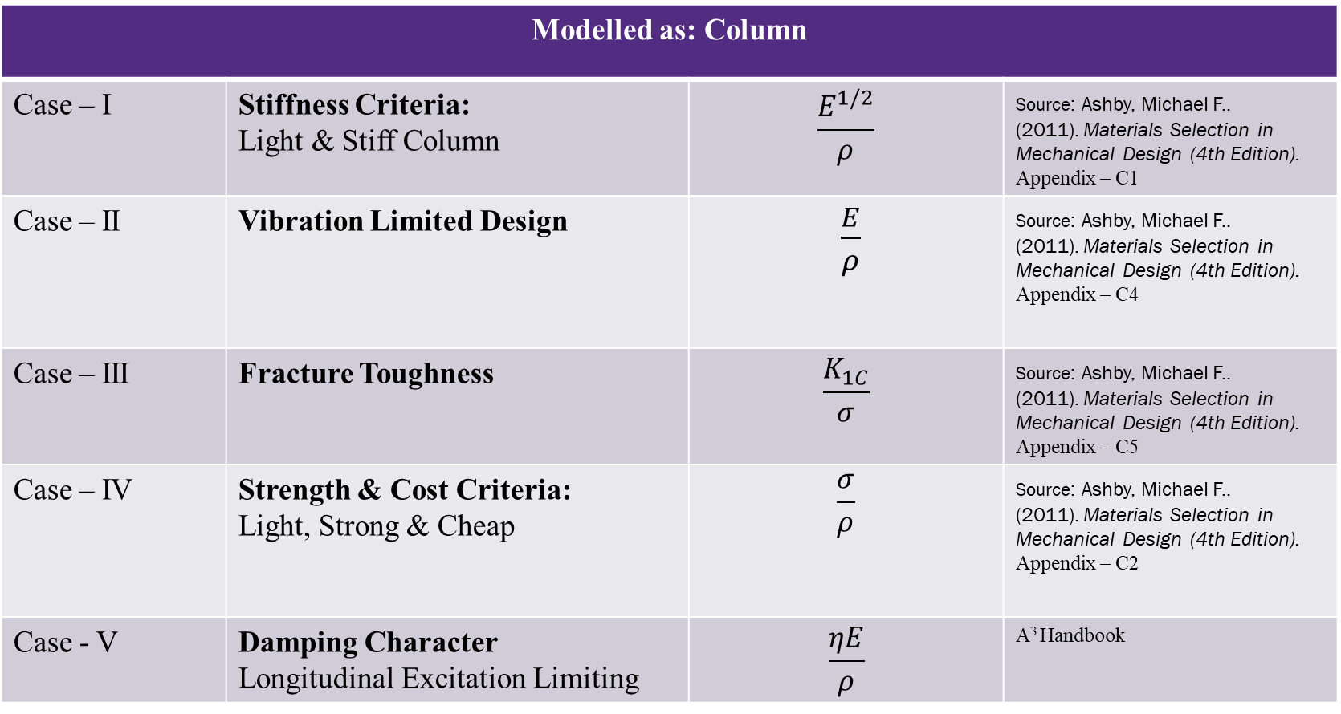
Material Indices
Modelled as: Column
Case – I | Stiffness Criteria: Light & Stiff Column | $$\frac{E^{1/2}}{ρ}$$ | Source: Ashby, Michael F.. (2011). Materials Selection in Mechanical Design (4th Edition). Appendix – C1
Case – II | Vibration Limited Design | $\frac{E}{ρ}$ | Source: Ashby, Michael F.. (2011). Materials Selection in Mechanical Design (4th Edition). Appendix – C4
Case – III | Fracture Toughness | $$\frac{K_{1C}}{σ}$$ | Source: Ashby, Michael F.. (2011). Materials Selection in Mechanical Design (4th Edition). Appendix – C5
Case – IV | Strength & Cost Criteria: Light, Strong & Cheap | $$\frac{σ}{ρ}$$ | Source: Ashby, Michael F.. (2011). Materials Selection in Mechanical Design (4th Edition). Appendix – C2
Case - V | Damping Character Longitudinal Excitation Limiting | $$\frac{ηE}{ρ}$$ | A³ Handbook
SEMESTER PROJECT PRESENTATION
10
Notes:
Based on the laid constraints, 5 Material Indices have been utilized to address all the design constraints.
Case – I addresses the stiffness criteria
Followed by Case – II which comes from Vibration Limited Design factor to avoid resonance prone low frequency profile
Case – III considers the Fracture toughness aspect , Finally Case – IV deals with the Strength Criteria coupled with Cost
Finally, CASE – V, Aims at limiting Longitudinal Excitations in the design

Slide 11
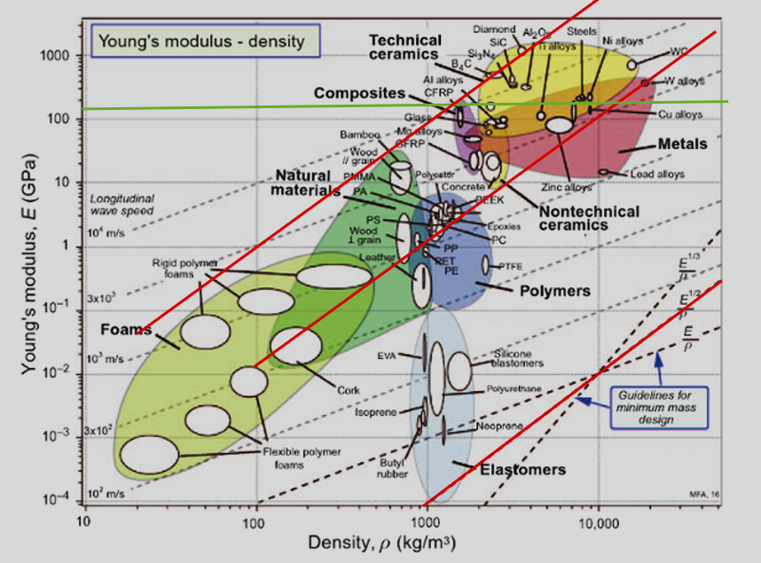
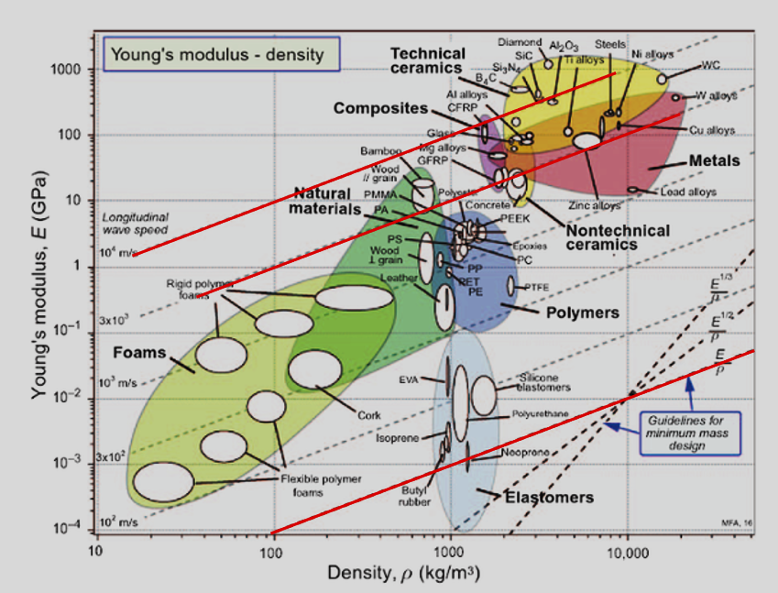
Material Selection Charts
Case I
Case II
SEMESTER PROJECT PRESENTATION
11
Notes:
Now, After scrolling through the Material Indices, Lets begin with Case – I: Stiffness Criteria
Followed by
Case – II for Vibration Limited Design
The red lines indicate the selection lines
Green line indicate the value of baseline material i.e AISI 4130 in our case.

Slide 12
Screening Process
Polymers
Foams
Technical Ceramics
Non-Technical Ceramics
Composites
SEMESTER PROJECT PRESENTATION
2
1
3
Technical Ceramics
Metals
Metals
Natural Materials
Composites
Natural Materials
12
Notes:
The Screening Process begins analogous with the Case – I (Stiffness Criteria) , Screenings out seven categories, elastomers have been ruled out in this case
Then further screening under Case –II (Vibration limited Design) leads to four categories of material i.e. Technical Ceramics , Composites, Metals and Natural Materials

Slide 13
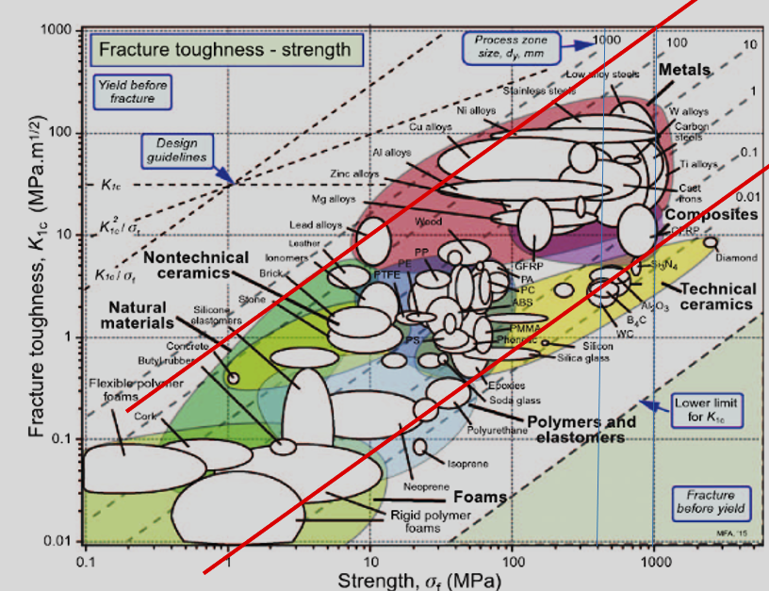
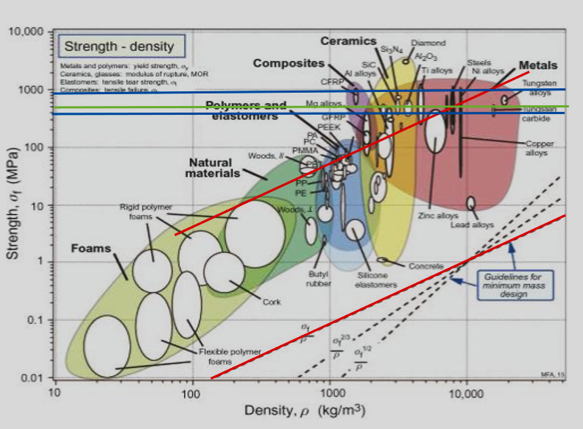
Material Selection Charts
Case III
Case IV (A)
SEMESTER PROJECT PRESENTATION
13
Notes:
Case – III deals with Fracture Toughness Criteria , wherein the Bounding Box of Yield Strength initially calculated , indicated by Blue line, is used to narrow down the search
Yellow Area highlighted is our target area in Case – III
We further screen materials out on Strength criteria to get a Light, Strong & Cheap Character.
Case – IV (A) further screens out on Light & Strong , Strength Criteria

Slide 14
Screening Process
Si₃N₄
Si₃N₄
Technical Ceramics
Al₂O₃
Technical Ceramics
SiC
B₄C
Al₂O₃
SiC
SEMESTER PROJECT PRESENTATION
CFRP
4A
Composites
CFRP
Composites
Low Alloy Steels
Titanium Alloys
Carbon Steel
Metals
Nickel Alloys
Cast Iron
Tungsten Alloys
Metals
Al Alloys
Stainless Steel
Titanium Alloys
Tungsten Alloys
Stainless Steel
Nickel Alloys
14
Notes:
Now, further screening under the Case – III (Fracture Toughness Material Indices), it is further screened into 1 Composites , 4 Technical Ceramics, 8 Metals
We continue the Screening Process, until this point, we have screened until the Case - III
Now, We further screen the materials based on Case – IV (A) : Strength Criteria and then coupled with Light, Strong and Cost Criteria
Until now, we have been left with 3 Technical ceramics, 1 Composite, 4 Metals

Slide 15
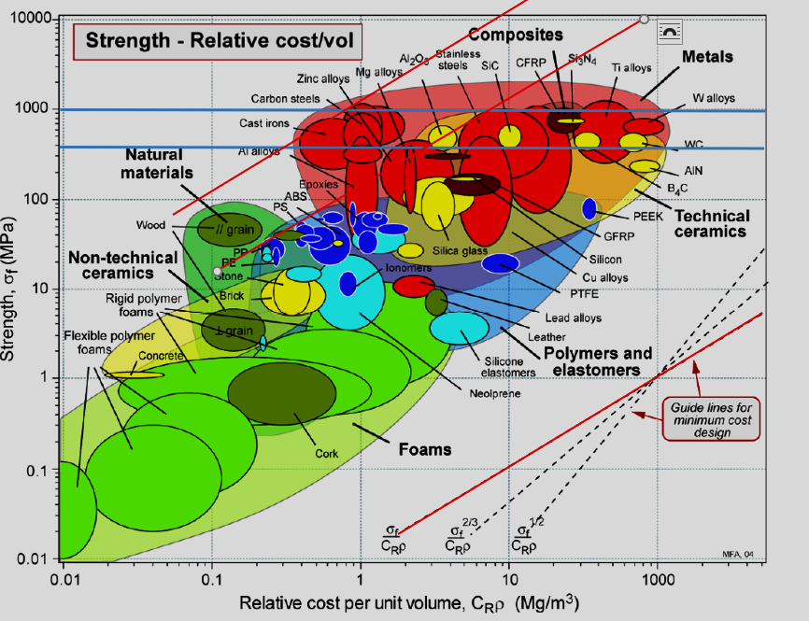
Material Selection Charts
Case IV (B)
SEMESTER PROJECT PRESENTATION
15
Notes:
Whereas In the Case IV(B), Cost criteria is introduced along with the Strength Criteria, to rule out material choices based on cost.

Slide 16
Screening Process
FINAL MATERIAL
Al₂O₃
Technical Ceramics
SiC
Al₂O₃
SEMESTER PROJECT PRESENTATION
CFRP
Composites
4B
5
Al₂O₃
Metals
Titanium Alloys
Stainless Steel
Stainless Steel
16
Notes:
Now, After the Case 4(B) screening on the lines of Cost, We are left with only two material candidates i.e
Al203 and Stainless Steel
After evaluating it against the Case – V, our final material selected is Alumina
Finally, As Observed Alumina is our final material selected, it comes with advantages to the entire design of towbar by including the elements of High Mechanical Strength, High Compressive Strength, Optimal Bending Resistance as required for the current application,
Displays Good NVH behavior, would be able to effectively prevent longitudinal excitations and lateral excitations to a certain extent
Finally, the overall design will be lightweight , making the towbar operation agile on the lines of ‘Easy to Operate’ by the Aviation Ground Staff.

Slide 17
Final Material Selection & Conclusion
Material Selected: Alumina (Al₂O₃)
Benefits of New Material:
High Mechanical Strength
High Compressive Strength
Optimal Bending Resistance
Good NVH behavior
Lightweight : ‘Easy to Operate’
SEMESTER PROJECT PRESENTATION
17
Notes:
Finally, As Observed Alumina is our final material selected, it comes with advantages to the entire design of towbar by including the elements of High Mechanical Strength, High Compressive Strength, Optimal Bending Resistance as required for the current application,
Displays Good NVH behavior, would be able to effectively prevent longitudinal excitations and lateral excitations to a certain extent
Finally, the overall design will be lightweight , making the towbar operation agile on the lines of ‘Easy to Operate’ by the Aviation Ground Staff.

